Slide 1


Vishal H. Suryawanshi
09-AUG-2022

Slide 2

Outline
Executive Summary
Introduction
Methodology
Results
Conclusion
Appendix

Slide 3
Executive Summary
Summary of methodologies
Data collection using SpaceX API
Data collection from Wikipedia using Web Scrapping
Data Wrangling
Exploratory Data Analysis using SQL
Exploratory Data Analysis using Data Visualization
Interactive Dashboard using Folium and Dash
Classification using Machine
Summary of all results
Exploratory Data Analysis result
Interactive Dashboard Screenshot
Classification using machine learning result

Slide 4
Introduction
Project background and context SpaceX advertises Falcon 9 rocket launches on its website with a cost of 62 million dollars; other providers cost upwards of 165 million dollars each, much of the savings is because SpaceX can reuse the first stage. Therefore, if we can determine if the first stage will land, we can determine the cost of a launch. In this project we will determine the price of each launch. We will do this by gathering information about Space X and creating dashboards for the team. We will also determine if SpaceX will reuse the first stage. Instead of using rocket science to determine if the first stage will land successfully, we will train a machine learning model and use public information to predict if SpaceX will reuse the first stage.
Problems you want to find answers
Which factors determines if the rocket will land successfully or not?
What is relation between different features which determines the success rate?
Which are the best operating conditions to ensure the successful landing of the rocket?

Slide 5

Section 1

Slide 6
Methodology
Executive Summary
Data collection methodology:
Data is collected using SpaceX API and Launch data on Wikipedia is collected using Web Scrapping.
Performed data wrangling
In data wrangling step handled missing values, data types and categorical values.
Performed exploratory data analysis (EDA) using visualization and SQL
Performed interactive visual analytics using Folium and Plotly Dash
Perform predictive analysis using classification models
How to build, tune, evaluate classification models

Slide 7
Data Collection
SpaceX launch data is collected using below two methods:
SpaceX API:
Using SpaceX API, we got the data in JASON format then we converted that JSON data into pandas DataFrame and performed data wrangling.
SpaceX URL : https://api.spacexdata.com/v4/launches/past
Payload Data: https://api.spacexdata.com/v4/payloads/
Rocket Data: https://api.spacexdata.com/v4/rockets/
Launch pad data: https://api.spacexdata.com/v4/launchpads/
After collecting all data, we performed data wrangling like handling missing values.

Slide 8
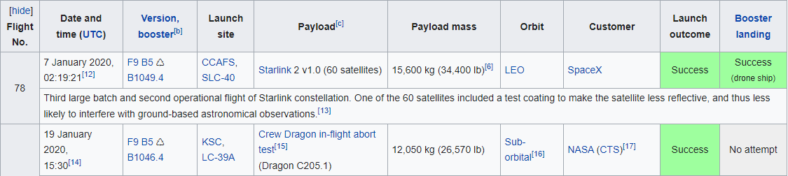
Data Collection
2. Web Scrapping:
Using Web scrapping we collected data of Falcon 9 historical launch records from a Wikipedia page titled `List of Falcon 9 and Falcon Heavy launches`.
URL : https://en.wikipedia.org/wiki/List_of_Falcon_9_and_Falcon_Heavy_launches

Slide 9
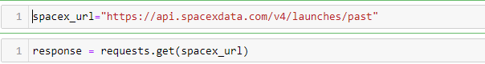
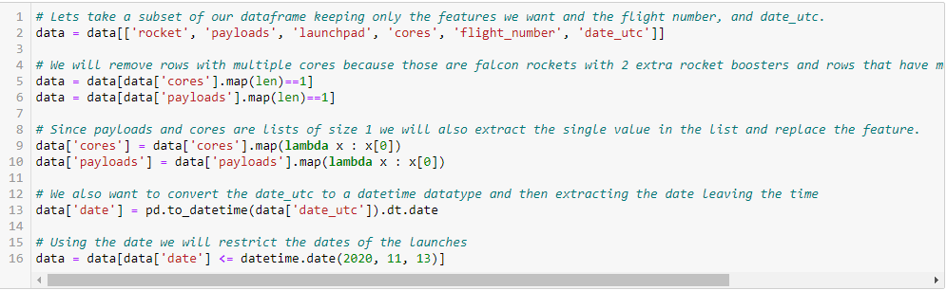
Data Collection – SpaceX API
1. Get request to SpaceX API
2. Json data to pandas dataframe
3. use the API again to get information about the launches using the IDs
We used get request to the SpaceX API and got the data in json format. Converted that json data into pandas DataFrame using pandas library.
After storing data in the dataframe we performed basic data wrangling steps like handling missing values.
GitHub URL: https://github.com/vishal-suryawanshi/DS101-Capstone-Project/blob/69af60c3829fe75645b52de5d57bf1b3bcd157ee/SpaceX%20Data%20Collection%20API.ipynb

Slide 10
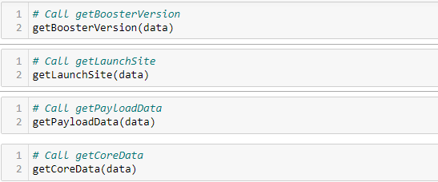
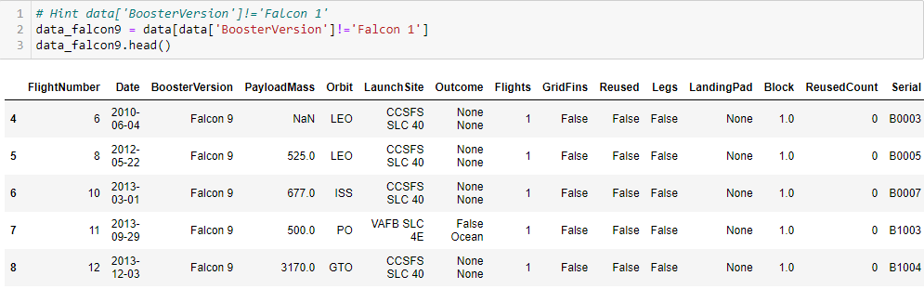
Data Collection – SpaceX API
4. API calls to get Booster Version, Launch Site Payload and Core Data.
5. Filter out Falcone 9 data:

Slide 11
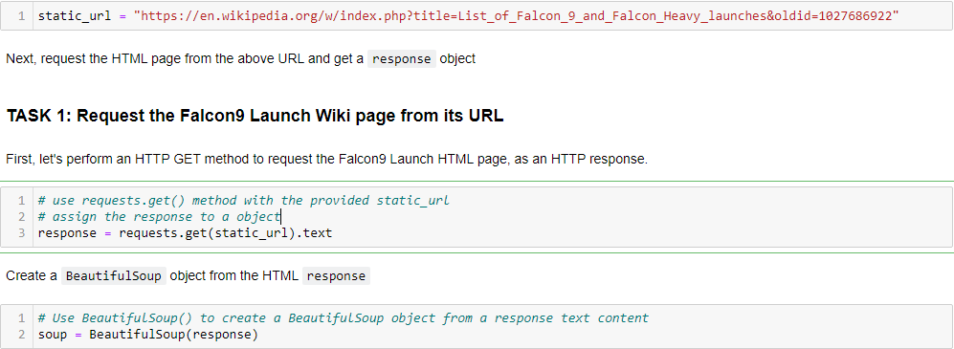
Data Collection - Scraping
Get data using http get request and using that response create BeautifulSoup object
Extract Column and headers of table using beautiful Soup
We performed web scraping to collect Falcon 9 historical launch records from a Wikipedia page titled `List of Falcon 9 and Falcon Heavy launches`
https://en.wikipedia.org/wiki/List_of_Falcon_9_and_Falcon_Heavy_launches
GitHub URL:
https://github.com/vishal-suryawanshi/DS101-Capstone-Project/blob/80271795ef0633663fd37a7d6aff3846620cdbcd/Webscraping.ipynb

Slide 12
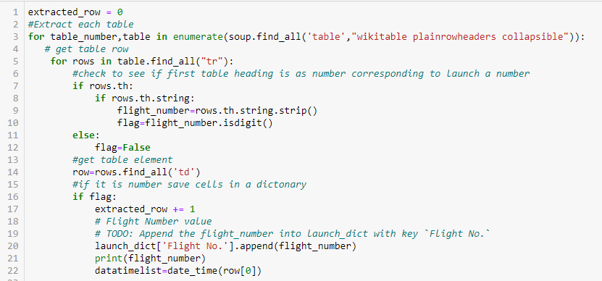
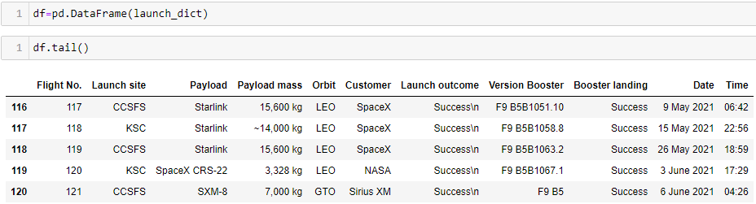
Data Collection - Scraping
3. Extract all row from response:
4. Store data into pandas dataframe:

Slide 13
Data Wrangling
In data wrangling step we performed Exploratory Analysis and determined training labels.
We calculated the number of launches at each site, and the number and occurrence of each orbits
We created landing outcome label from outcome column and exported the results to csv.
We calculated number of occurrences in each orbit.
We calculated the number and occurrences of mission outcome per orbit type
GitHub URL: https://github.com/vishal-suryawanshi/DS101-Capstone-Project/blob/80271795ef0633663fd37a7d6aff3846620cdbcd/Spacex%20Data%20wrangling.ipynb

Slide 14
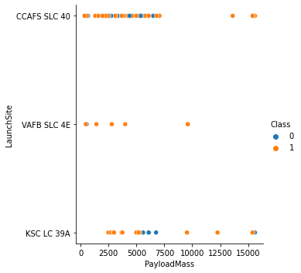
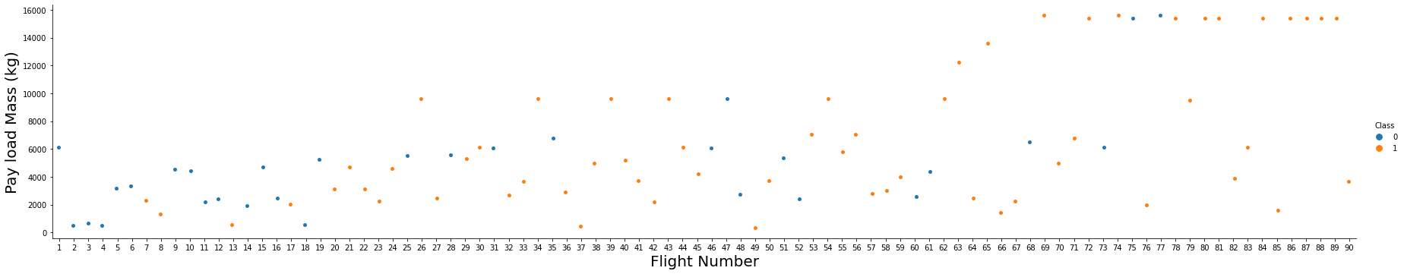
EDA with Data Visualization
We explored the data by visualizing the relationship between flight number and launch Site, payload and launch site, success rate of each orbit type, flight number and orbit type, the launch success yearly trend.
We observed Payload Vs. Launch Site scatter point chart you will find for the VAFB-SLC launch site there are no rockets launched for heavy payload mass(greater than 10000).
We see that different launch sites have different success rates. CCAFS LC-40, has a success rate of 60 %, while KSC LC-39A and VAFB SLC 4E has a success rate of 77%.
GitHub URL: https://github.com/vishal-suryawanshi/DS101-Capstone-Project/blob/a8436b682bb1aeaa29fabf196a9aae5c7790fbbc/EDA%20Data%20Visualization%20.ipynb

Slide 15
EDA with SQL
We loaded SpaceX data using sqlalchemy and performed Exploratory data analysis using sql extension in jupyter notebook.
We applied EDA with SQL to get insight from the data. We wrote queries to find out for instance:
The names of unique launch sites in the space mission.
The total payload mass carried by boosters launched by NASA (CRS)
The average payload mass carried by booster version F9 v1.1
The total number of successful and failure mission outcomes
The failed landing outcomes in drone ship, their booster version and launch site names.
GitHub URL: https://github.com/vishal-suryawanshi/DS101-Capstone-Project/blob/0c6d52f6236f6c566e3a25c58988d12fda3262f7/jupyter-labs-eda-sql-coursera_sqllite.ipynb

Slide 16
Build an Interactive Map with Folium
We marked all launch sites, and added map objects such as markers, circles, lines to mark the success or failure of launches for each site on the folium map.
We assigned the feature launch outcomes (failure or success) to class 0 and 1.i.e., 0 for failure, and 1 for success.
Using the color-labeled marker clusters, we identified which launch sites have relatively high success rate.
We calculated the distances between a launch site to its proximities. We answered some question for instance:
Are launch sites near railways, highways and coastlines.
Do launch sites keep certain distance away from cities.
GitHub URL: https://github.com/vishal-suryawanshi/DS101-Capstone-Project/blob/4d1b92a0416da8e701942014d342092807b4d250/Interactive%20map%20using%20Folium.ipynb
Folium Images: https://github.com/vishal-suryawanshi/DS101-Capstone-Project/tree/main/Folium%20Images

Slide 17
Build a Dashboard with Plotly Dash
We built an interactive dashboard with Plotly dash.
We plotted pie charts showing the total launches by a certain sites, After selecting any launch site from dropdown it will show the percentage of successful and Failed launch for that launch site.
We plotted scatter graph showing the relationship with Outcome and Payload Mass (Kg) for the different booster version. Also provided Payload Mass slider from range 0 Kg to 1000 Kg.
GitHub URL:
Python File: https://github.com/vishal-suryawanshi/DS101-Capstone-Project/blob/80271795ef0633663fd37a7d6aff3846620cdbcd/Interactive%20Dashboard%20with%20Ploty%20Dash.py
Images: https://github.com/vishal-suryawanshi/DS101-Capstone-Project/tree/main/Images

Slide 18
Predictive Analysis (Classification)
We loaded the data using into DataFrame using pandas, transformed the data, split our data into training and testing using train_test_split.
We built Logistic Regression, KNN, SVM and Decision tree machine learning classification models and tuned with different hyperparameters using GridSearchCV.
We used accuracy as the metric for our model, improved the model using feature engineering and algorithm tuning.
We found the best performing classification model. In our case it is decision tree is a best model with accuracy of 87%.
GitHub URL: https://github.com/vishal-suryawanshi/DS101-Capstone-Project/blob/5712c6733aa974b6db25d59ce0f926f687abc094/SpaceX_Machine%20Learning%20Prediction_Part_5.ipynb

Slide 19
Results
Exploratory data analysis results
different launch sites have different success rates. CCAFS LC-40, has a success rate of 60 %, while KSC LC-39A and VAFB SLC 4E has a success rate of 77%.
For the VAFB-SLC launch site there are no rockets launched for heavy payload mass(greater than 10000).
In the LEO orbit the Success appears related to the number of flights; on the other hand, there seems to be no relationship between flight number when in GTO orbit.
With heavy payloads the successful landing or positive landing rate are more for Polar, LEO and ISS. However, for GTO we cannot distinguish this well as both positive landing rate and negative landing(unsuccessful mission) are both there here.
Success rate since 2013 kept increasing till 2020.

Slide 20
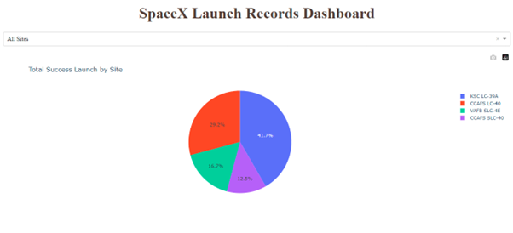
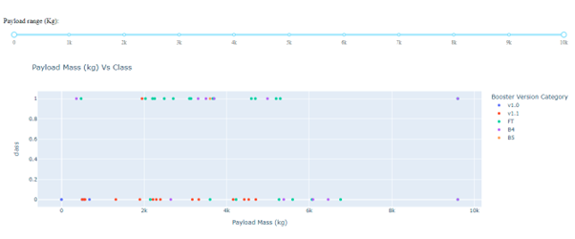
Results
Interactive analytics demo in screenshots

Slide 21
Results
Predictive analysis results
Logistic Regression accuracy: 0.8464285714285713
SVM accuracy: 0.8482142857142856
Decision Tree accuracy: 0.8625
KNN accuracy: 0.8482142857142858
Decision Tree performs best with accuracy of 86.25%
Best Parameters of tree : {'criterion': 'gini', 'max_depth': 2, 'max_features': 'sqrt', 'min_samples_leaf': 2, 'min_samples_split': 5, 'splitter': 'best'}

Slide 22

Section 2

Slide 23
Flight Number vs. Launch Site
We see that as the flight number increases, the first stage is more likely to land successfully.
The payload mass is also important; it seems the more massive the payload, the less likely the first stage will return.

Slide 24
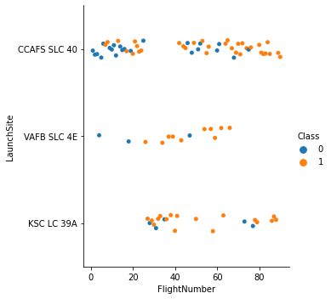
Payload vs. Launch Site
We see that different launch sites have different success rates.
CCAFS LC-40, has a success rate of 60 %, while KSC LC-39A and VAFB SLC 4E has a success rate of 77%.

Slide 25
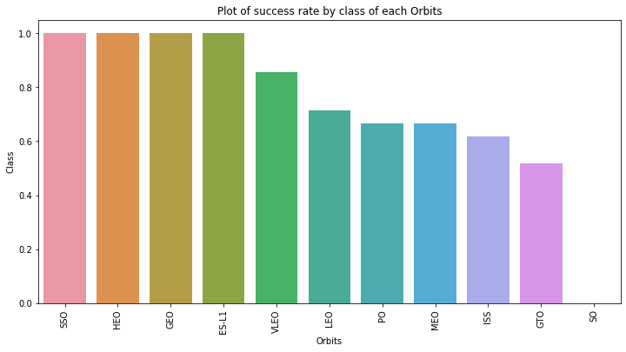
Success Rate vs. Orbit Type
From the plot, we can see that ES-L1, GEO, HEO, SSO, VLEO had the most success rate.
From VLEO to SO success rate goes on decreasing.

Slide 26
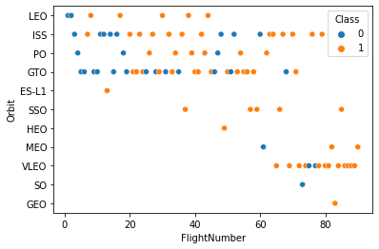
Flight Number vs. Orbit Type
LEO orbit the Success appears related to the number of flights; on the other hand, there seems to be no relationship between flight number when in GTO orbit.
VLEO and SSO has more success rate

Slide 27
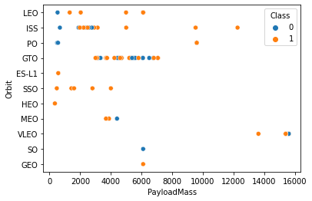
Payload vs. Orbit Type
With heavy payloads the successful landing or positive landing rate are more for Polar, LEO and ISS.
However for GTO we cannot distinguish this well as both positive landing rate and negative landing(unsuccessful mission) are both there here.

Slide 28
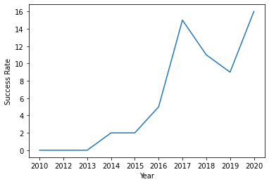
Launch Success Yearly Trend
Success rate since 2013 kept increasing till 2020

Slide 29
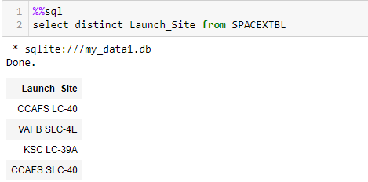
All Launch Site Names
We used distinct Key word to get unique Launch site names.
There are total 4 launch sites.

Slide 30
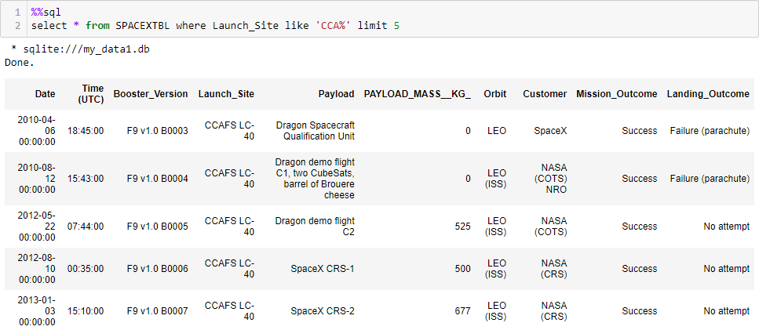
Launch Site Names Begin with 'CCA'
We use like key word to match pattern and limit key word to limit the number of records

Slide 31
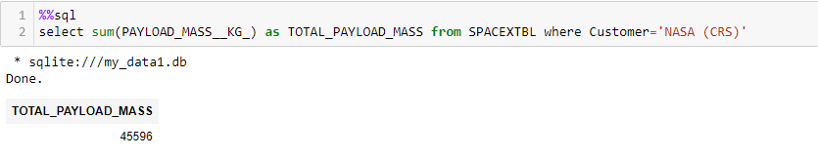
Total Payload Mass
Calculate the total payload carried by boosters from NASA we used SUM function of sql with Customer filter.

Slide 32
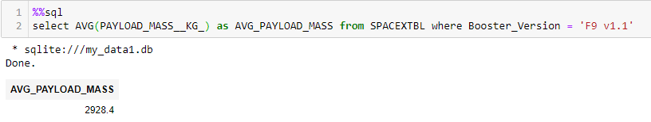
Average Payload Mass by F9 v1.1
To calculate the average payload mass carried by booster version F9 v1.1 we used AVG function of SQL with filter on Booster version

Slide 33
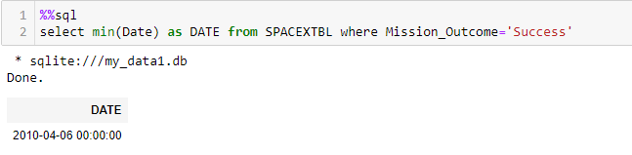
First Successful Ground Landing Date
To find the dates of the first successful landing outcome on ground pad we used MIN function of sql on date column with filter on Mission Outcome column

Slide 34
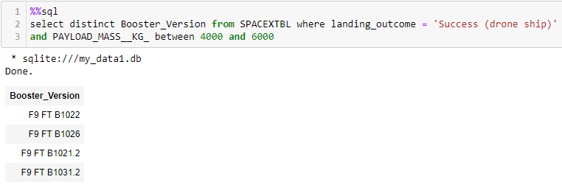
Successful Drone Ship Landing with Payload between 4000 and 6000
We used where clause and between key word to find the successful lading with Payload mass between 4000 and 6000.

Slide 35
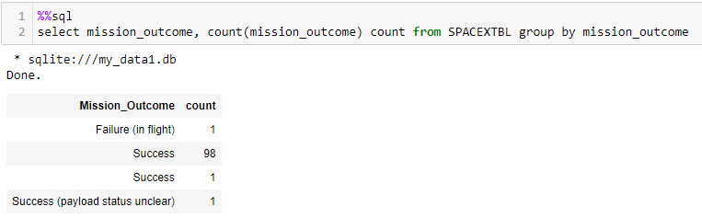
Total Number of Successful and Failure Mission Outcomes
To calculate the total number of successful and failure mission outcomes we used count aggregate function of SQL and group by clause on mission outcome.

Slide 36
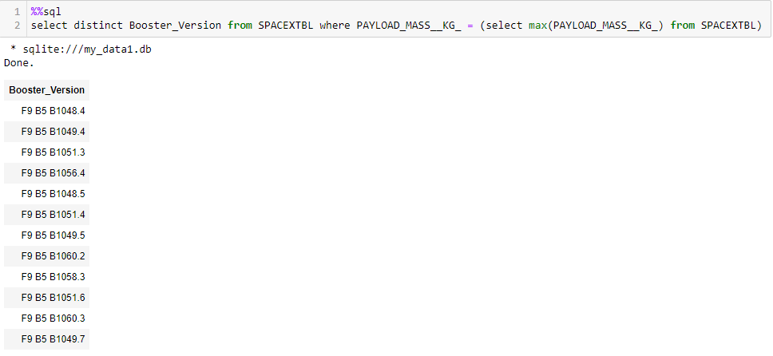
Boosters Carried Maximum Payload
There are total 12 boosters which carried maximum payload mass. To find out this we used sub-query to find out maximum payload mass. And the filtered all booters with maximum payload mass. Also used distinct key word to avoid duplicate result.

Slide 37
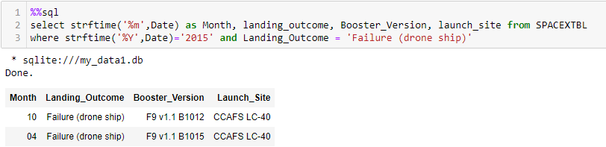
2015 Launch Records
We used strftime() function of sql to extract month and year from date and compared that year with 2015 also used filter on landing outcome table.

Slide 38
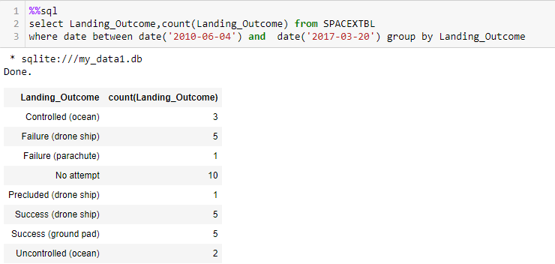
Rank Landing Outcomes Between 2010-06-04 and 2017-03-20
We selected Landing outcomes and the COUNT of landing outcomes from the data and used the WHERE clause to filter for landing outcomes BETWEEN 2010-06-04 to 2010-03-20.
We applied the GROUP BY clause to group the landing outcomes and the ORDER BY clause to order the grouped landing outcome in descending order.

Slide 39

Section 3

Slide 40
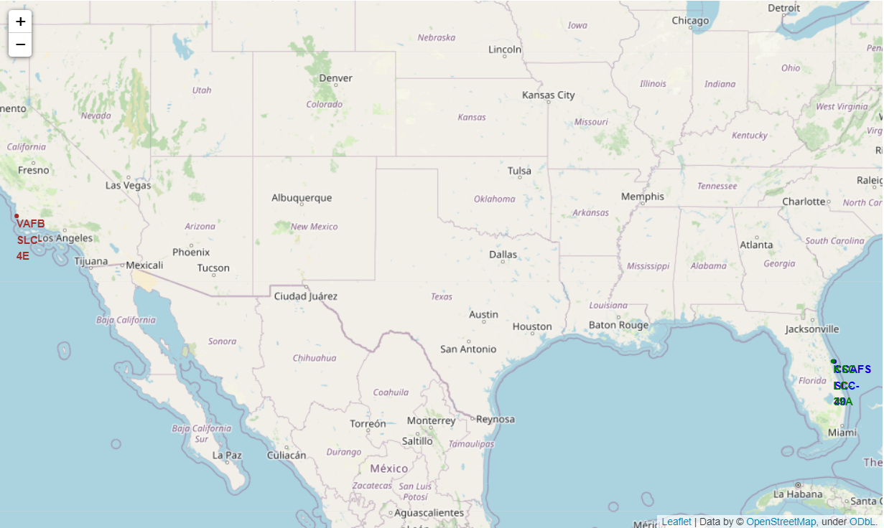
Folium Map: All launch Sites
There are total four launch sites of SpaceX one present west coastline of America and other 3 present at east coastline

Slide 41

Folium Map: Launch Outcome

Slide 42
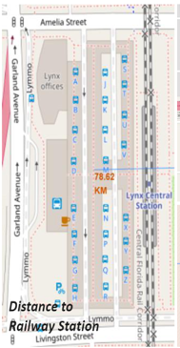
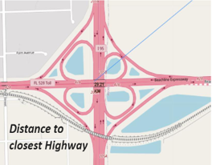
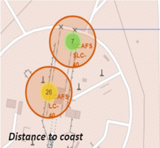
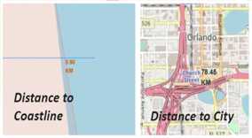
Folium Map: Launch site to its proximities

Slide 43

Section 4

Slide 44
Pie chart: success percentage achieved by each launch site
KSC LC-39A has most successful launches from among all sites

Slide 45
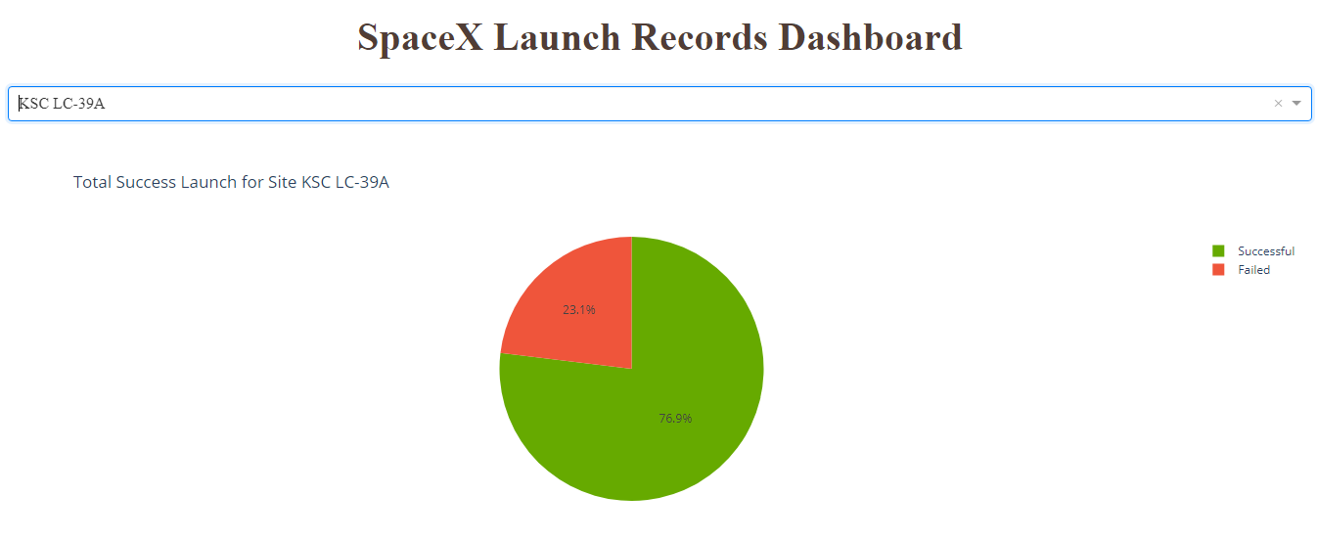
Pie chart: Launch site with the highest launch success ratio
KSC LC-39A achieved highest success rate of 76.9% and 23.1% failure rate

Slide 46
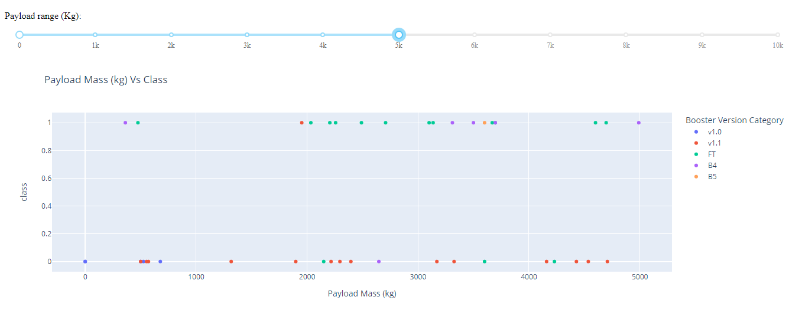
Scatter plot of Payload vs Launch Outcome
Payload range between 0 Kg to 5000 Kg

Slide 47
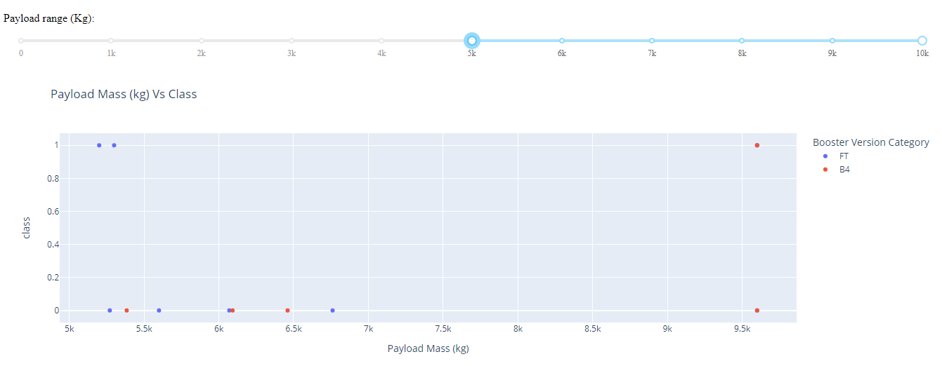
Scatter plot of Payload vs Launch Outcome
Payload range between 5000 Kg to 10000 Kg

Slide 48
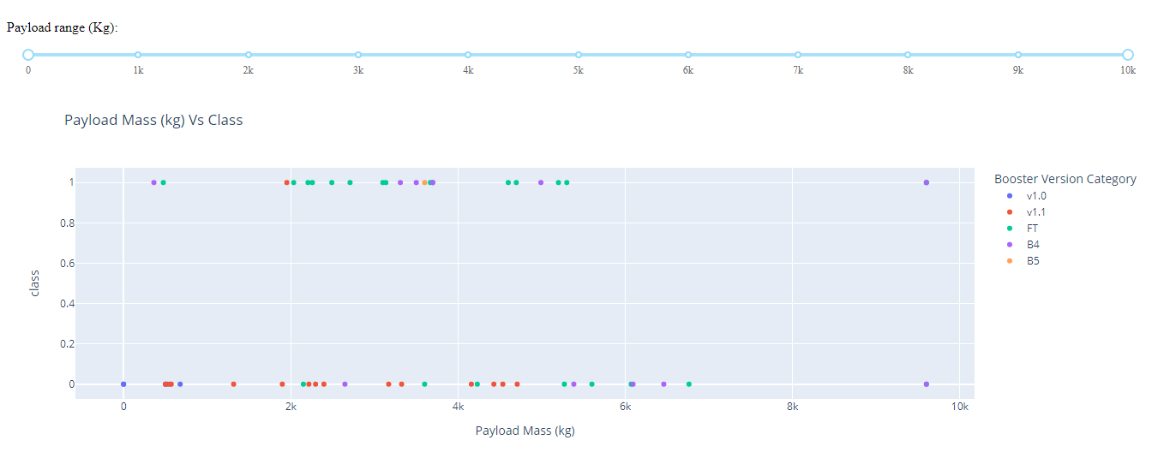
Scatter plot of Payload vs Launch Outcome
Payload range between 0 Kg to 10000 Kg

Slide 49

Section 5

Slide 50
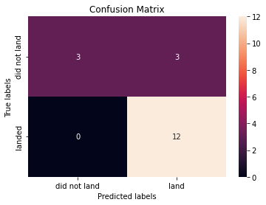
Confusion Matrix
Best performing model is Decision Tree with accuracy of 87%
The confusion matrix for the decision tree classifier shows that the classifier can distinguish between the different classes. The major problem is the false positives .i.e., unsuccessful landing marked as successful landing by the classifier.

Slide 51
Conclusions
We can conclude that:
As the flight number increases, the first stage is more likely to land successfully.
It seems the more massive the payload, the less likely the first stage will return.
With heavy payloads the successful landing or positive landing rate are more for Polar, LEO and ISS.
Success rate since 2013 kept increasing till 2020
Orbits ES-L1, GEO, HEO, SSO, VLEO has the most success rate.
KSC LC-39A has the most successful launches of any sites.
The Decision tree classifier is the best machine learning algorithm for this task.

Slide 52
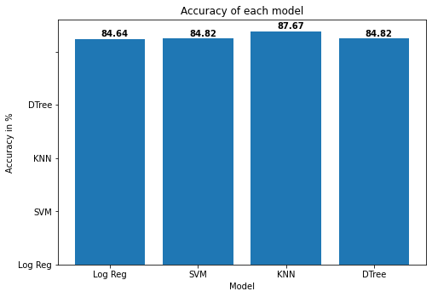
Classification Accuracy
Decision Tree model has highest accuracy of 87.67%

Slide 53


